Slide 1
Team Neophytes
WFS_PUN_4_TEAM_1
Sulagna Dutta Choudhury
Vaishnavi Sharma
Saurabh Dhote
Charu Saini
Falguni Jawalkar
Aryan Bardoh
Aryan Madaan
Misba Farheen

Slide 2
ORDER
PROCESSING
SYSTEM

Slide 3
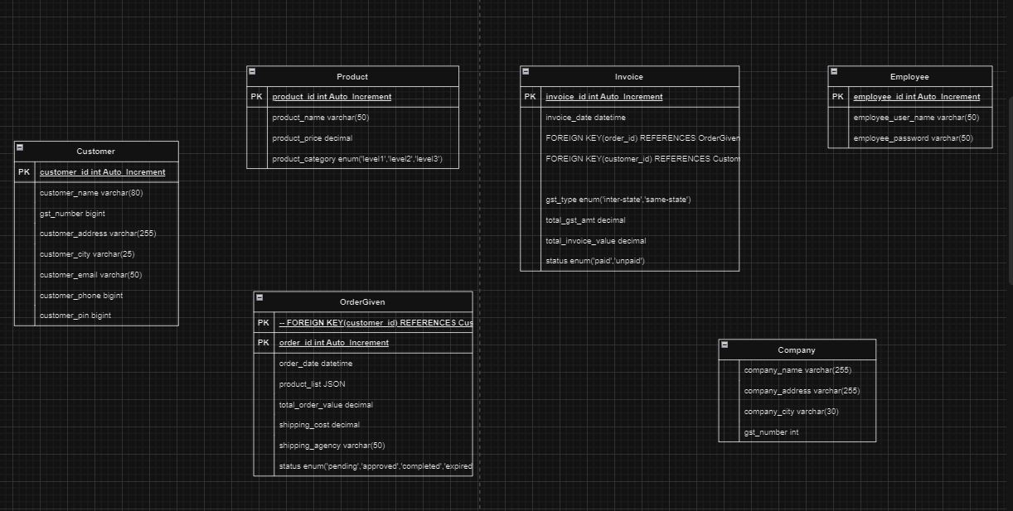
ER DIAGRAM

Slide 4
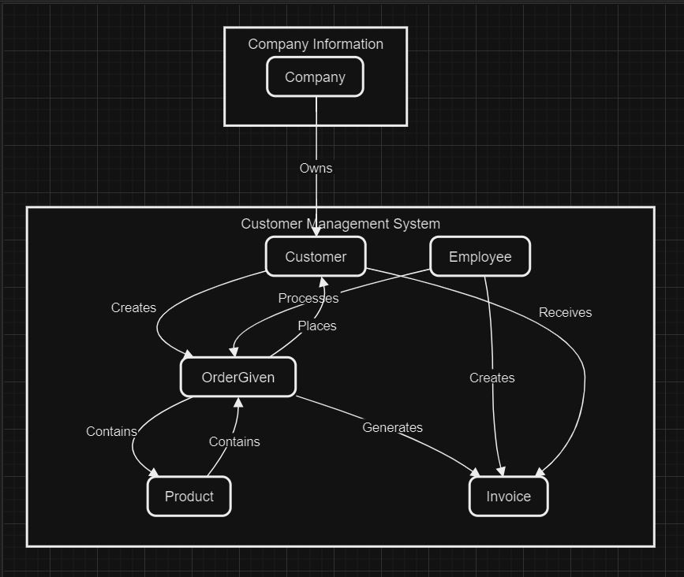
DATA
FLOW
DIAGRAM

Slide 5
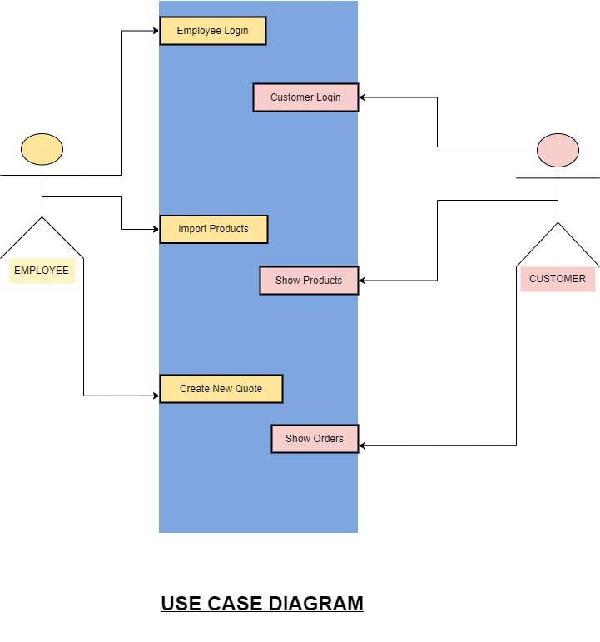
USE
CASE DIAGRAM

Slide 6

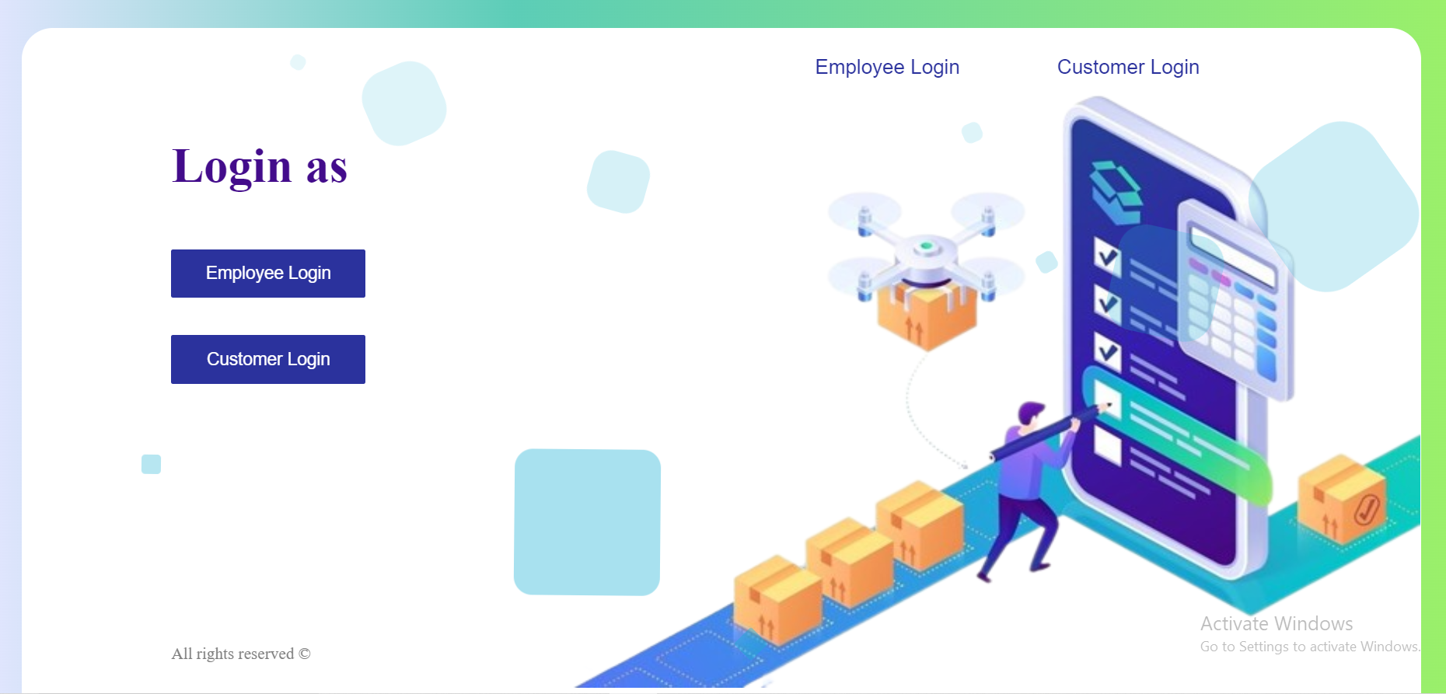
Home Page

Slide 7
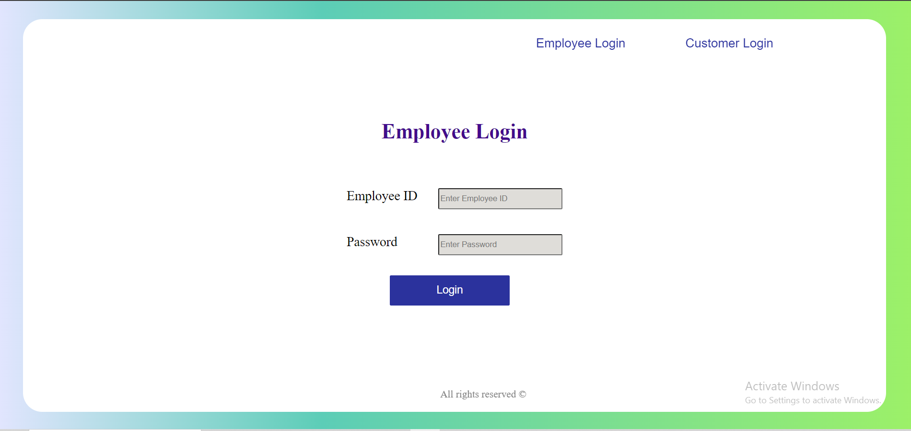
Employee Login Page

Slide 8
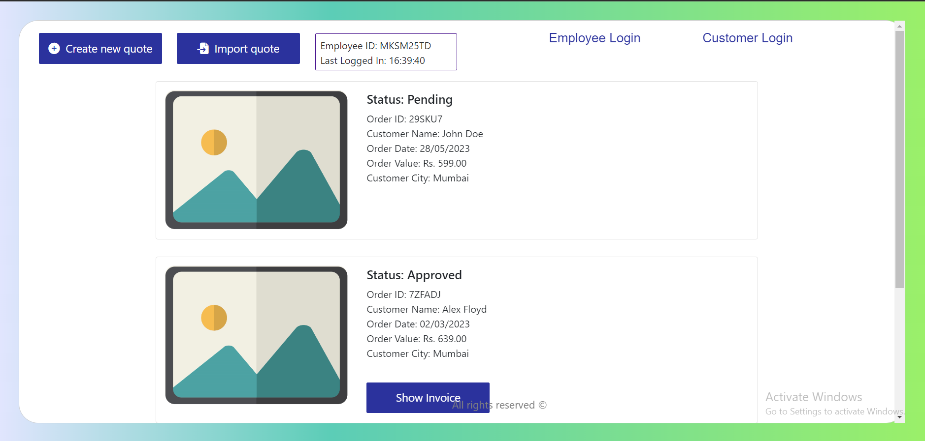
Order Management Page (for Employee)

Slide 9
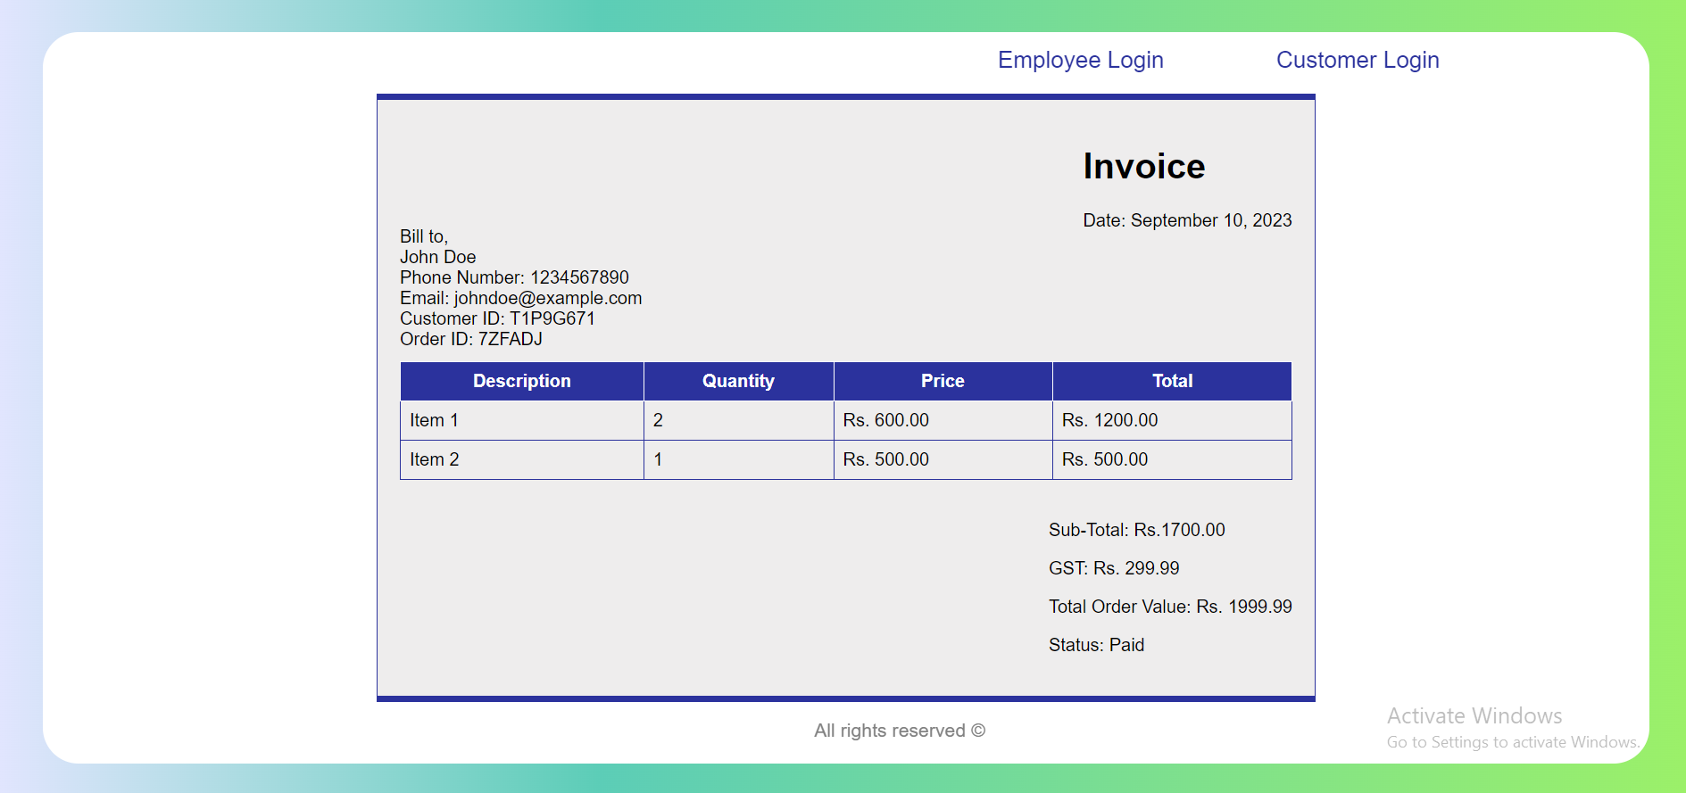
Invoice Page

Slide 10
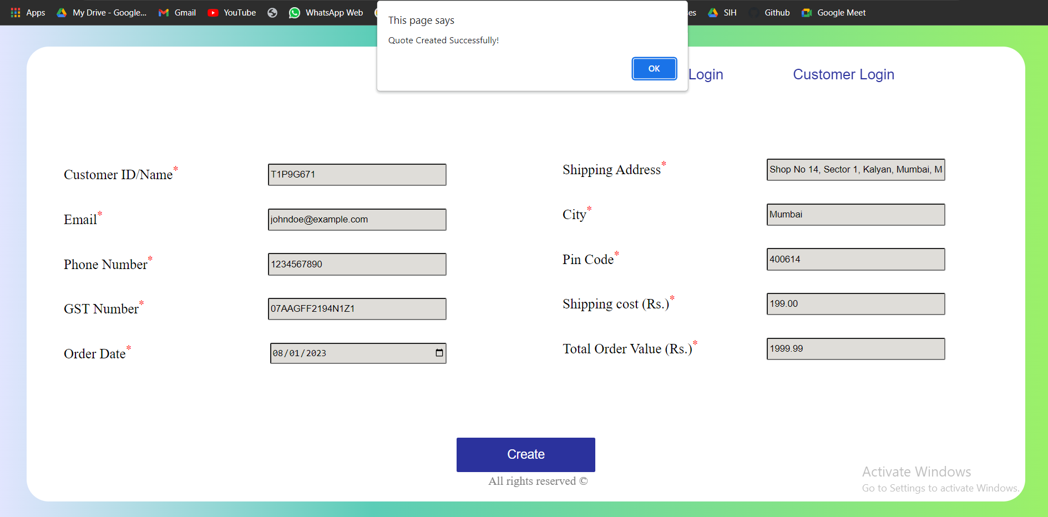
Create New Quote Page

Slide 11
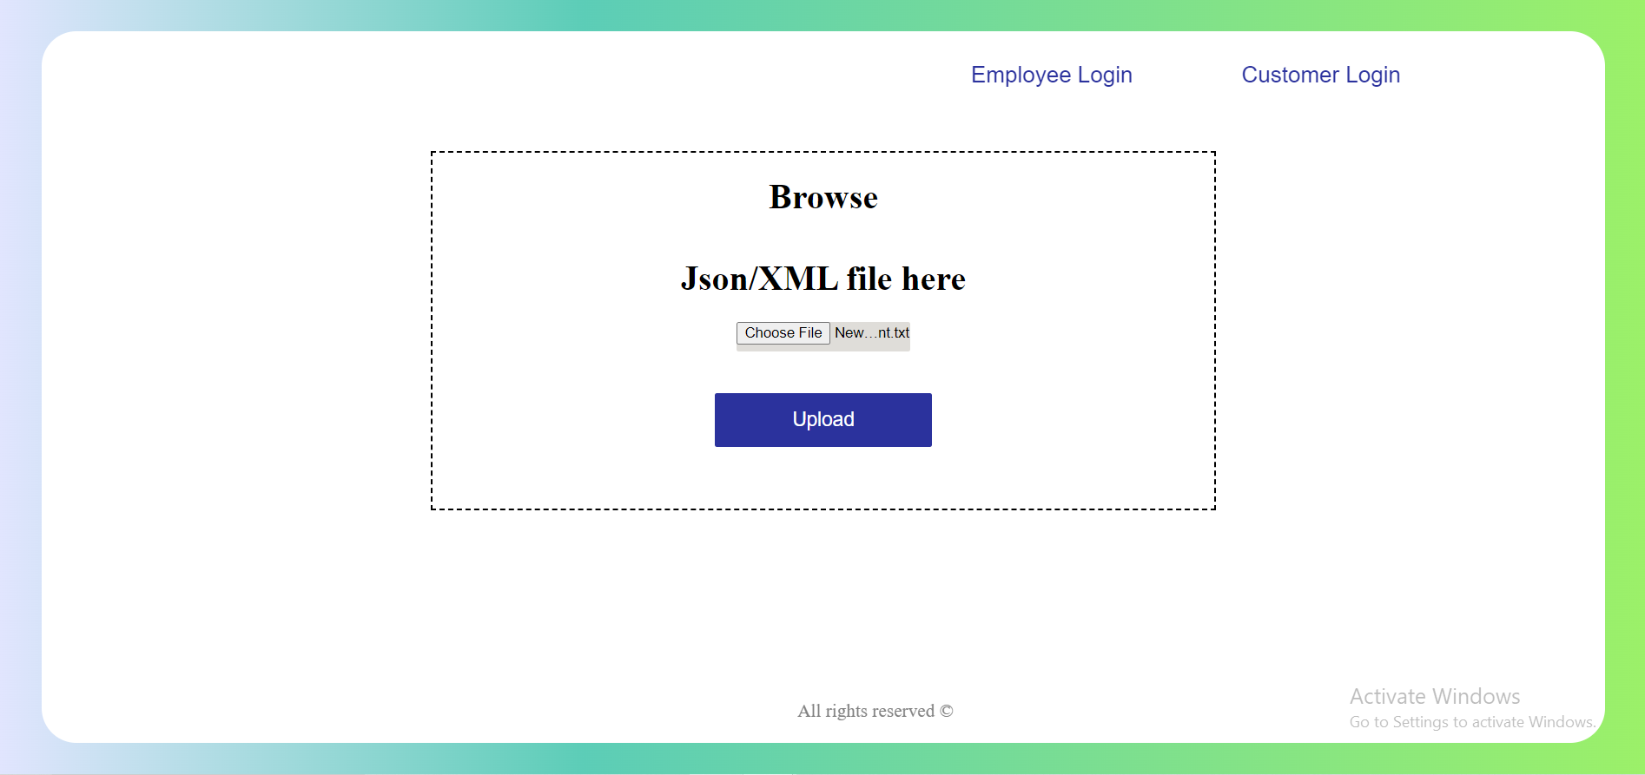
Import Quote Page

Slide 12
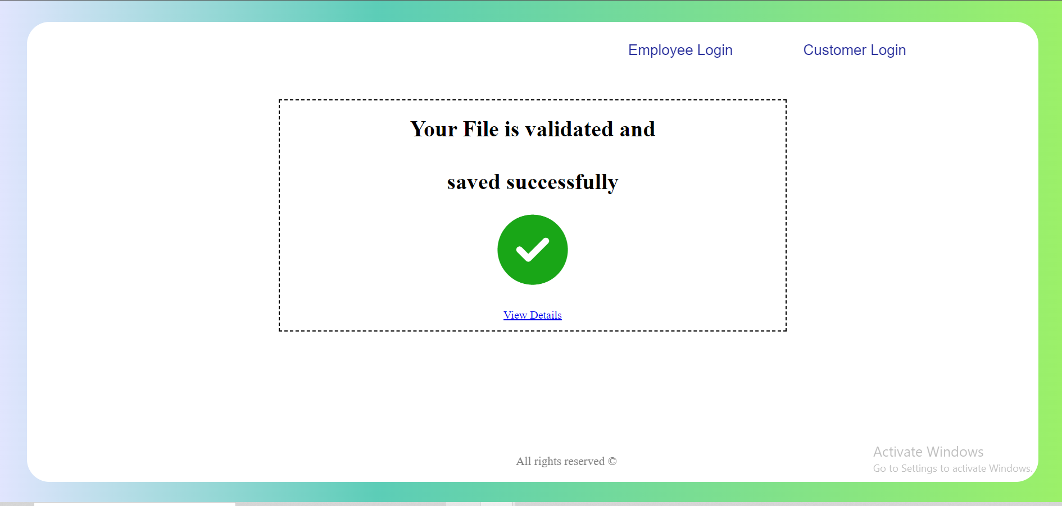
Validating Imported File

Slide 13
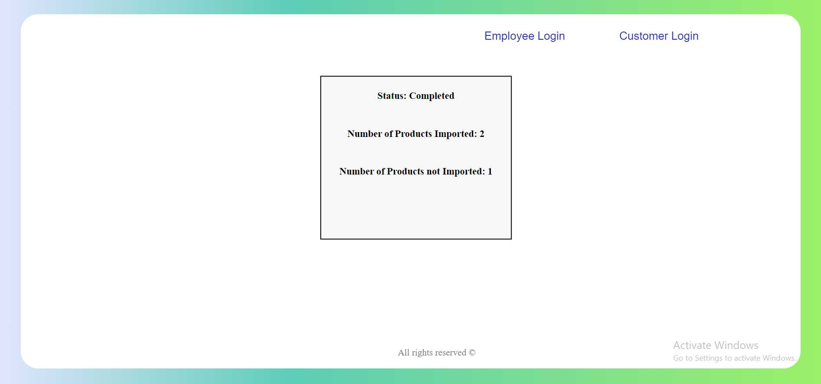
Details of Import Page

Slide 14

Customer Login Page

Slide 15
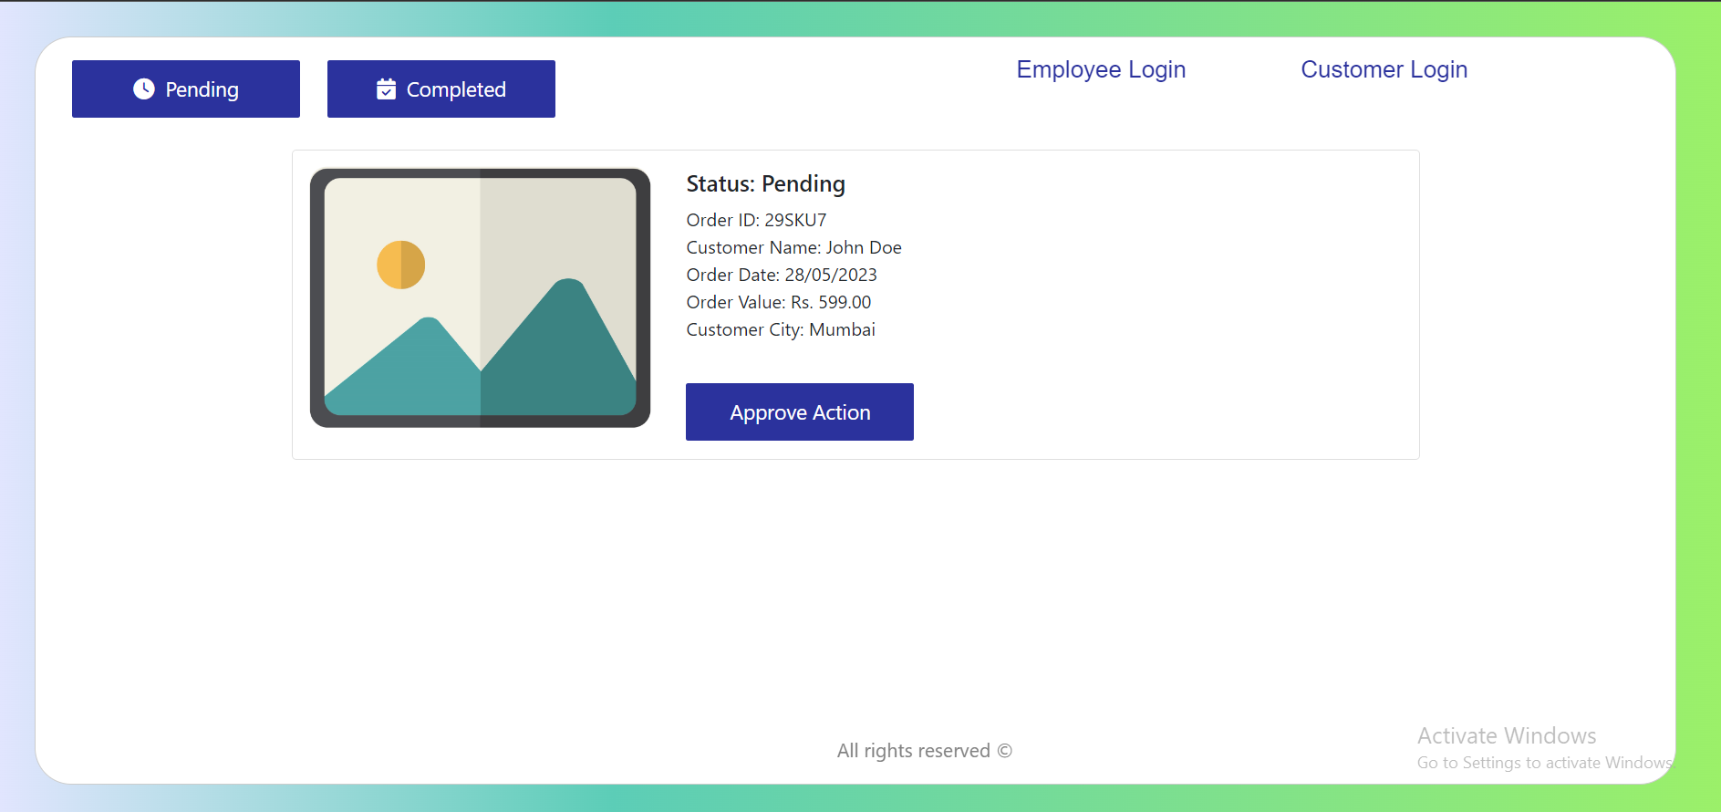
Order Management Page (for Customer)
Shows all pending requests

Slide 16
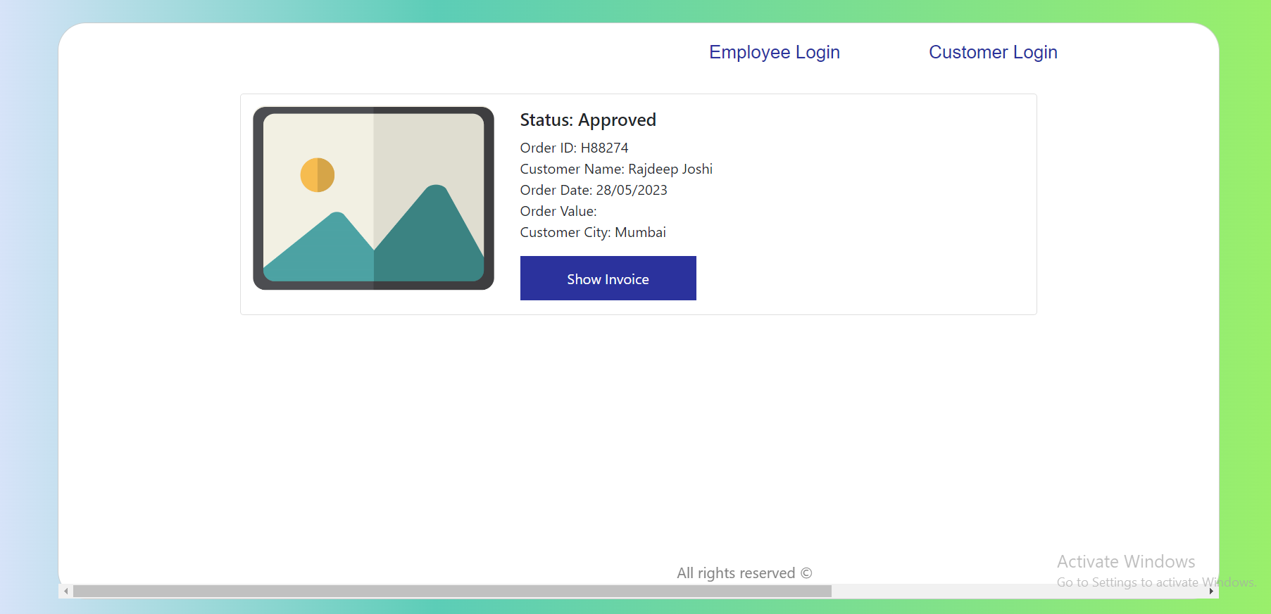
Approved the Pending Order

Slide 17
Invoice Page

Slide 18
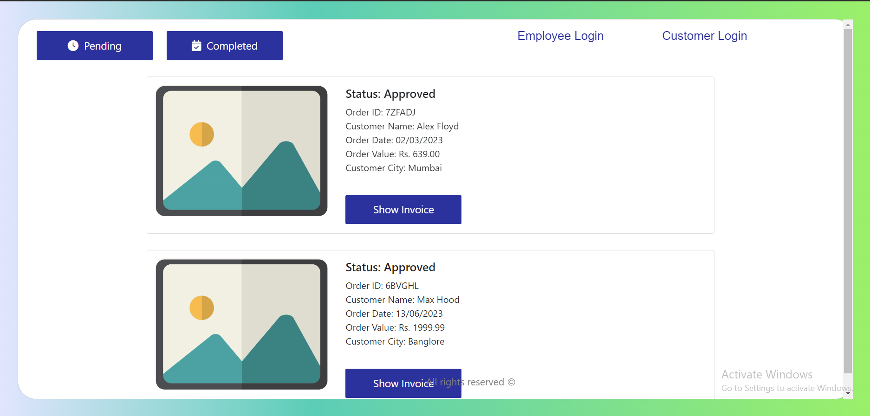
Shows all approved orders

Slide 19
Invoice Page

Slide 20
Console Output

Slide 21
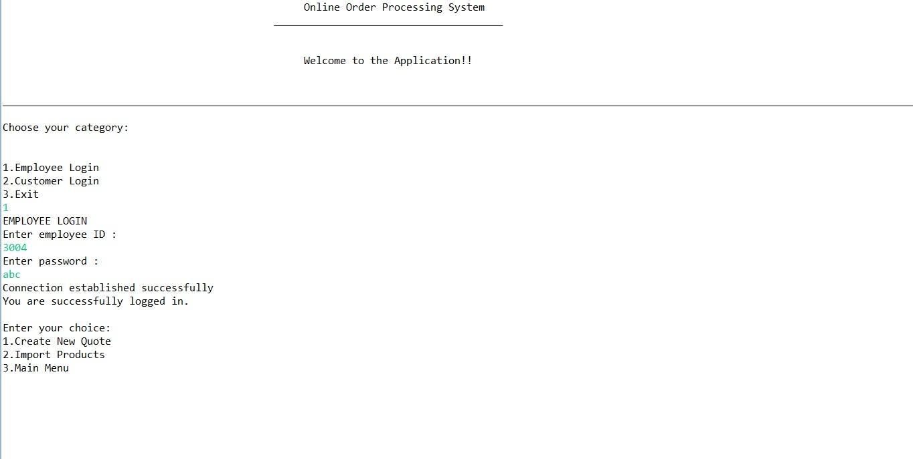

Slide 22
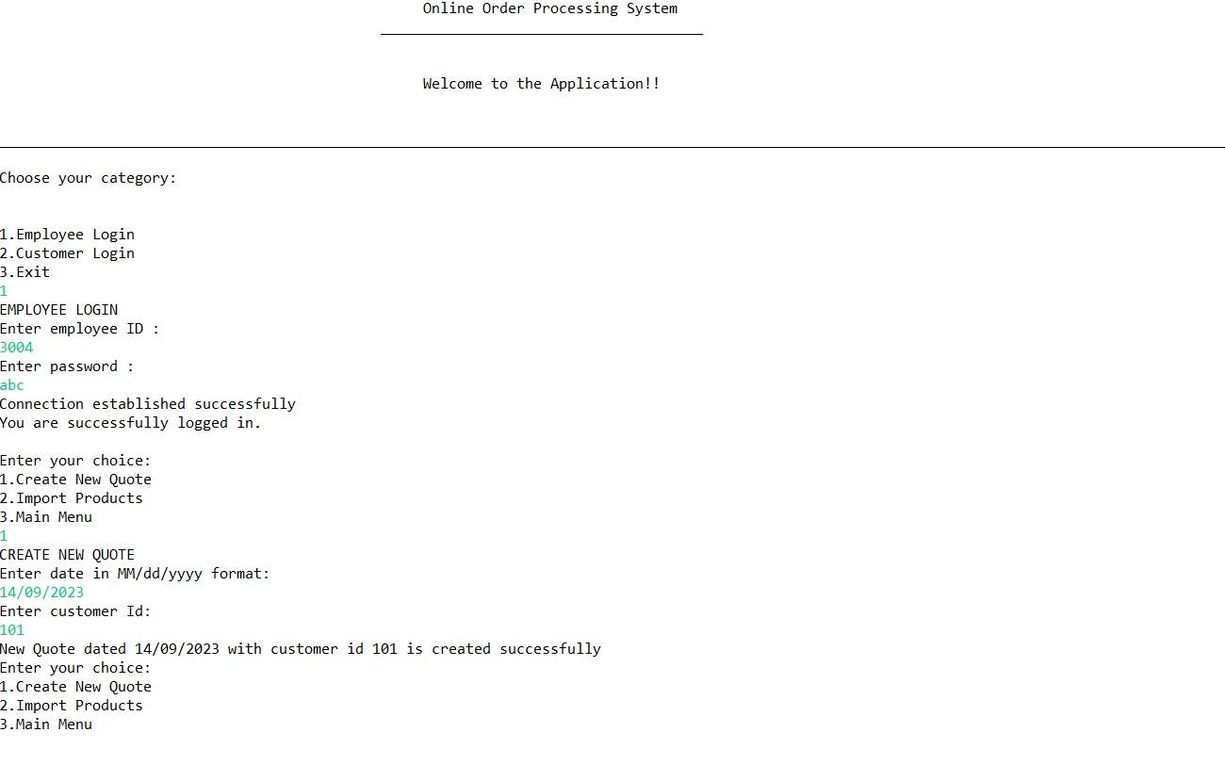

Slide 23
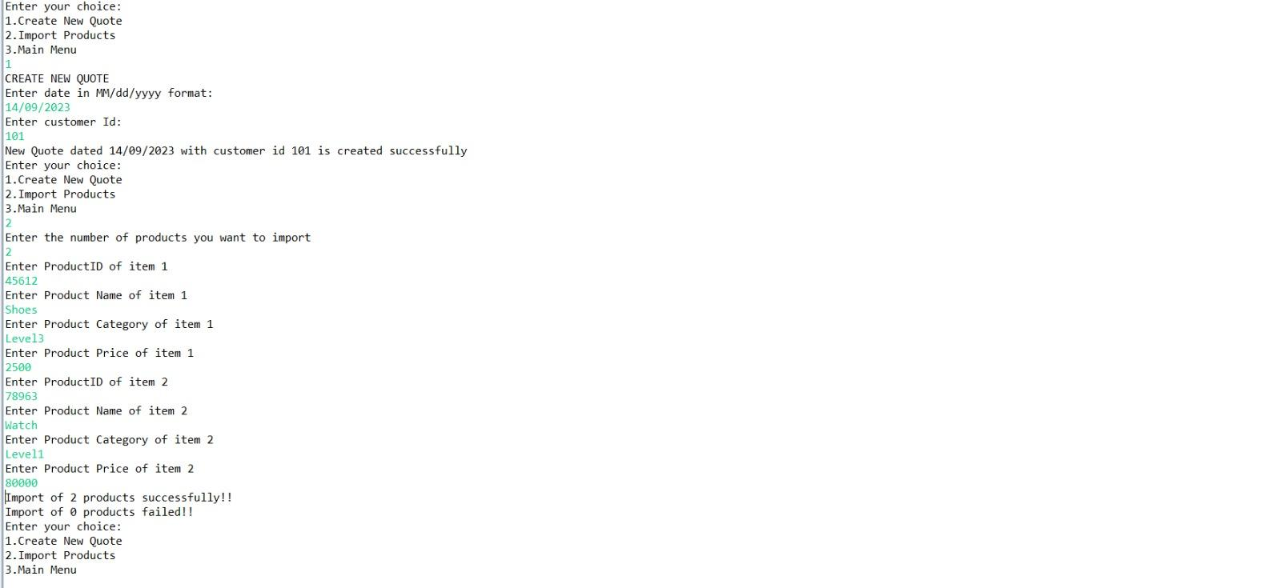

Slide 24
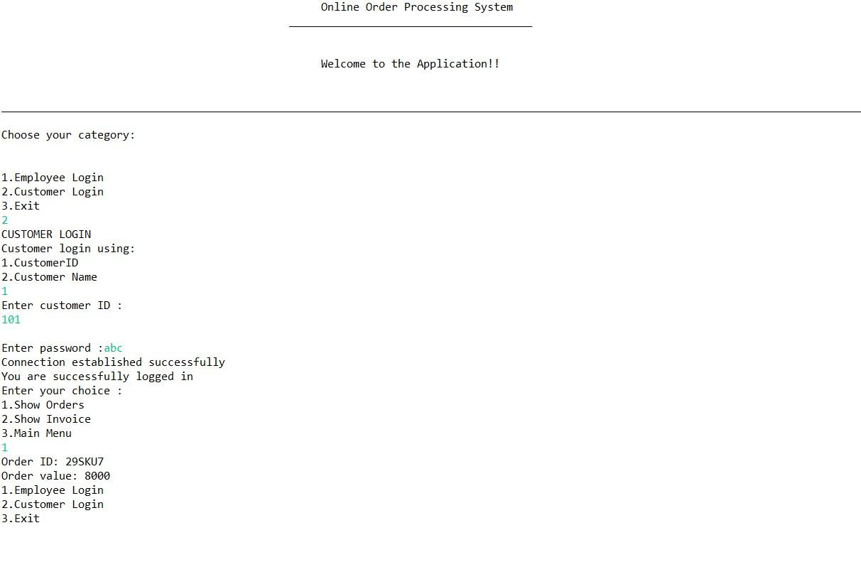

Slide 25
